Slide 1

Management
15th Edition, Global Edition
Capítulo 5
Gestão da Diversidade
Gravar Ms Teams!
Copyright © 2018 Pearson Education, Ltd. All Rights Reserved

Slide 2
Objetivos
4.1 Definir o que é diversidade no local de trabalho e explicar porque é que a sua gestão é importante.
4.2 Explicar os diferentes tipos de diversidade no local de trabalho.
4.3 Descrever os desafios que os gestores enfrentam na gestão da diversidade.
4.4 Descrever as diversas iniciativas de gestão da diversidade.

Slide 3
O que é a diversidade nas organizações?
Diversidade nas organizações
Modo como as pessoas de uma organização são diferentes, ou semelhantes, umas das outras.
Notes:
Diversity has been “one of the most popular business topics over the last two decades.” It ranks with modern business disciplines such as quality, leadership, and ethics. Despite this popularity, it’s also one of the most controversial and least understood topics. With its basis in civil rights legislation and social justice, the word diversity often invokes a variety of attitudes and emotional responses in people.
So, what’s our definition of workplace diversity? We’re defining it as the ways in which people in an organization are different from and similar to one another. Notice that our definition not only focuses on the differences, but the similarities, of employees. This reinforces our belief that managers and organizations should view employees as having qualities in common as well as differences that separate them.

Slide 4
Figura 4-1
História da evolução da diversidade
Timeframe | Events
1960s to 1970s | Focus on complying with laws and regulations: Title VII of Civil Rights Act; Equal Employment Opportunity Commission; affirmative action policies and programs
Early 1980s | Focus on assimilating minorities and women into corporate setting: Corporate programs developed to help improve self-confidence and qualifications of diverse individuals so they can “fit in”
Late 1980s | Concept of workforce diversity expanded from compliance to an issue of business survival: Publication of Workforce 2000 opened business leaders’ eyes about the future composition of workforce—that is, more diverse; first use of term workforce diversity
Late 1980s to Late 1990s | Focus on fostering sensitivity: Shift from compliance and focusing only on women and minorities to include everyone; making employees more aware and sensitive to the needs and differences of others
New Millennium | Focus on diversity and inclusion for business success: Workforce diversity seen as core business issue; important to achieve business success, profitability, and growth
Notes:
Diversity has traditionally been considered a term used by human resources departments, associated with fair hiring practices, discrimination, and inequality. But diversity today is considered to be so much more. Exhibit 4-1 illustrates a historical overview of how the concept and meaning of workforce diversity has evolved.
Source: Based on “The New Global Mindset: Driving InnovationThrough Diversity” by Ernst &Young, January 27, 2010.

Slide 5
Tipos de Diversidade
Diversidade superficial
Diferenças facilmente percebidas e que podem dar origem a estereótipos, mas que não refletem necessariamente os pensamentos e sentimentos das pessoas.
Diversidade
acentuada
Diferenças em valores, personalidade, e preferências quanto às práticas de trabalho.
Notes:
The demographic characteristics that we tend to think of when we think of diversity—age, race, gender, ethnicity, and so on—are just the tip of the iceberg. These demographic differences reflect surface-level diversity, which are easily perceived differences that may trigger certain stereotypes but that do not necessarily reflect the ways people think or feel. Such surface-level differences in characteristics can affect the way people perceive others, especially when it comes to assumptions or stereotyping.
As people get to know one another, these surface-level differences become less important and deep-level diversity—differences in values, personality, and work preferences—becomes more important. These deep-level differences can affect the way people view organizational work rewards, communicate, react to leaders, negotiate, and generally behave at work.

Slide 6
Porque é importante gerir a diversidade nas organizações?
Gestão das pessoas
Desempenho organizacional
Interesse estratégico
Notes:
Diversity is, after all, about people, both inside and outside the organization. The people management benefits that organizations get because of their workforce diversity efforts revolve around attracting and retaining a talented workforce.
Performance benefits that organizations get from workforce diversity include cost savings and improvements in organizational functioning. The cost savings can be significant when organizations that cultivate a diverse workforce reduce employee turnover, absenteeism, and the chance of lawsuits.
Organizations also benefit strategically from a diverse workforce. You have to look at managing workforce diversity as the key to extracting the best talent, performance, market share, and suppliers from a diverse country and world. One important strategic benefit is that with a diverse workforce, organizations can better anticipate and respond to changing consumer needs. Diverse employees bring a variety of points of view and approaches to opportunities, which can improve how the organization markets to diverse consumers.

Slide 7
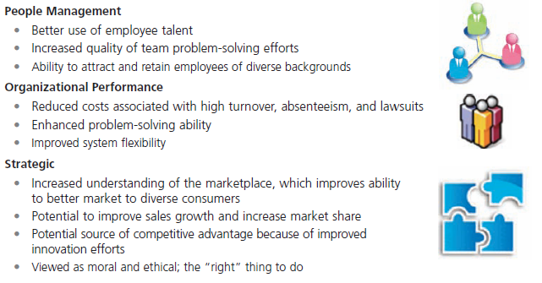
Figura 4-1
Benefícios da Diversidade
People Management
Better use of employee talent
Increased quality of team problem-solving efforts
Ability to attract and retain employees of diverse backgrounds
Organizational Performance
Reduced costs associated with high turnover, absenteeism, and lawsuits
Enhanced problem-solving ability
Improved system flexibility
Strategic
Increased understanding of the marketplace, which improves ability to better market to diverse consumers
Potential to improve sales growth and increase market share
Potential source of competitive advantage because of improved innovation efforts
Viewed as moral and ethical; the "right " thing to do

Slide 8
Mudanças demográficas nos EUA
Group | 2015 | 2050
Foreign-born | 14% | 19%
Racial/ethnic groups | blank | blank
White* | 72% | 47%
Hispanic | 12% | 29%
Black* | 12% | 13%
Asian* | 4% | 9%
* = Non-Hispanic | blank | blank
American Indian/Alaska Native not included. | blank | blank
Notes:
As the projections show, the main changes will be in the percentages of the Hispanic and white population. But the data also indicate that the Asian population will more than double.
Sources: Based on “Population Density by County,” U.S. Census Bureau, www. census.gov, accessed February 24, 2016; H. El Nasser, “U.S. Hispanic Population to Triple by 2050,” USA Today, February 12, 2008; and J. Passel and D. Cohn, “U.S. Population Projections: 2005–2050,” Pew Research Center, February 11, 2008.

Slide 9
Tipos de diversidade nas organizações
Notes:
As we’ve seen so far, diversity is a big issue, and an important issue, in today’s workplaces. What types of dissimilarities—that is, diversity—do we find in those workplaces? Exhibit 4-5 shows several types of workplace diversity. Let’s work our way through the different types.

Slide 10
Tipos de diversidade nas organizações
Idade
Género
Raça
Etnia
Deficiência
Religião
Orientação / Identificação
Outros tipos de diversidade
Notes:
As we’ve seen so far, diversity is a big issue, and an important issue, in today’s workplaces. What types of dissimilarities—that is, diversity—do we find in those workplaces? Exhibit 4-5 shows several types of workplace diversity. Let’s work our way through the different types.

Slide 11
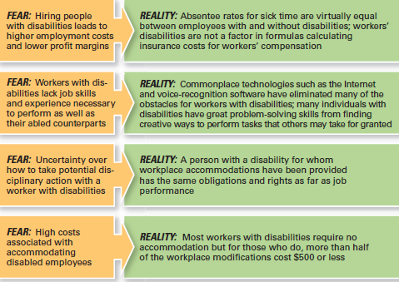
Receio dos empregadores quanto aos trabalhadores com deficiência
Notes:
Even after 20-plus years of the ADA, organizations and managers still have fears about employing disabled workers. A survey by the U.S. Department of Labor looked at these unfounded fears. Exhibit 4-6 describes some of those fears as well as the reality; that is, what it’s really like.
Sources: Based on R. Braum, “Disabled Workers: Employer Fears Are Groundless,” Bloomberg BusinessWeek, October
2, 2009; and “Survey of Employer Perspectives on the Employment of People with Disabilities,” U.S. Department of Labor/Office of Disability Employment Policy, November 2008.

Slide 12
Desafios na gestão da diversidade
Enviesamentos - Tendência ou preferência por uma determinada ideologia ou perspetiva. Os enviesamentos conduzem aos estereótipos, preconceitos e discriminação
Estereótipos – Julgar uma pessoa com base numa perceção pouco fundamentada, sobre o grupo a que a essa pessoa pertence (Componente cognitivo)
Preconceito - Sentimento ou julgamento pré-concebido, sobre uma pessoa ou grupo de pessoas (Componente afetivo)
Discriminação – atos resultantes do preconceito (Componente comportamental)
Notes:
Despite the benefits that we know workforce diversity brings to organizations, managers still face challenges in creating accommodating and safe work environments for diverse employees.
Bias is a term that describes a tendency or preference toward a particular perspective or ideology. It’s generally seen as a “one-sided” perspective. Our personal biases cause us to have preconceived opinions about people or things. Such preconceived opinions can create all kinds of inaccurate judgments and attitudes. One outcome of our personal biases can be prejudice, a preconceived belief, opinion, or judgment toward a person or a group of people. Our prejudice can be based on all the types of diversity we discussed: race, gender, ethnicity, age, disability, religion, sexual orientation, or even other personal characteristics.
A major factor in prejudice is stereotyping, which is judging a person on the basis of one’s perception of a group to which he or she belongs. For instance, “Married persons are more stable employees than single persons” is an example of stereotyping. Keep in mind, though, that not all stereotypes are inaccurate. However, many stereotypes aren’t factual and distort our judgment.
Both prejudice and stereotyping can lead to someone treating others who are members of a particular group unequally. That’s discrimination, which is when someone acts out their prejudicial attitudes toward people who are the targets of their prejudice.
You’ll find in Exhibit 4-7 definitions and examples of different types of discrimination. Many of these actions are prohibited by law, so you won’t find them discussed in employee handbooks or organizational policy statements. However, you can still see these actions in workplaces. As discrimination has increasingly come under both legal scrutiny and social disapproval, most overt forms have faded, which may have resulted in an increase in more covert forms such as incivility or exclusion.

Slide 13
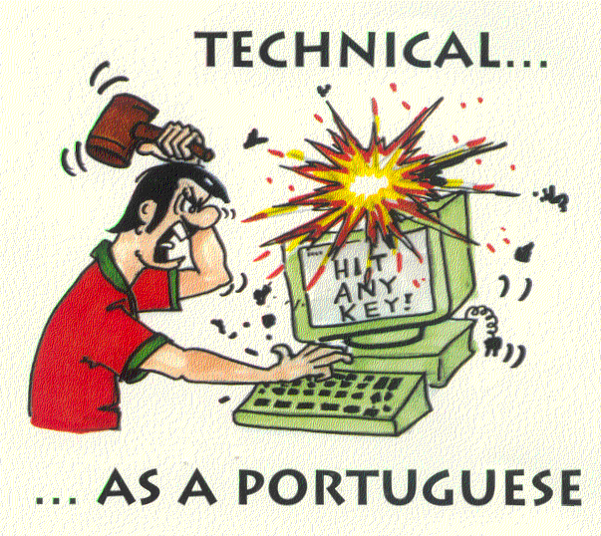
Estereótipos

Slide 14
Formas de Discriminação
Types of Discrimination | Definition | Examples from Organizations
Discriminatory policies or practices | Actions taken by representatives of the organization that deny equal opportunity to perform or unequal rewards for performance | Older workers may be targeted for layoffs because they are highly paid and have lucrative benefits. ª
Sexual harassment | Unwanted sexual advances and other verbal or physical conduct of a sexual nature that create a hostile or offensive work environment | Salespeople at one company went on company-paid visits to strip clubs, brought strippers into the office to celebrate promotions, and fostered pervasive sexual rumors. ^{b}
Intimidation | Overt threats or bullying directed at members of specific groups of employees | African American employees at some companies have found nooses hanging over their work stations. ^{c}
Mockery and insults | Jokes or negative stereotypes; sometimes the result of jokes taken too far | Arab Americans have been asked at work whether they were carrying bombs or were members of terrorist organizations. ^{d}
Exclusion | Exclusion of certain people from job opportunities, social events, discussions, or informal mentoring; can occur unintentionally | Many women in finance claim they are assigned to marginal job roles or are given light workloads that don’t lead to promotion. ^{e}
Incivility | Disrespectful treatment, including behaving in an aggressive manner, interrupting the person, or ignoring his or her opinions | Female lawyers note that male attorneys frequently cut them off or do not adequately address their comments. ^{f}
Notes:
Notes:
a. J. Levitz and P. Shishkin, “More Workers Cite Age Bias After Layoffs,” Wall Street Journal, March 11, 2009, pp.
D1–D2.
W. M. Bulkeley, “A Data-Storage Titan Confronts Bias Claims,” Wall Street Journal, September 12, 2007, pp. A1,
A16.
D. Walker, “Incident with Noose Stirs Old Memories,” McClatchy-Tribune Business News, June 29, 2008; and
D. Solis, “Racial Horror Stories Keep EEOC Busy,” Knight-Ridder Tribune Business News, July 30, 2005, p. 1.
d. H. Ibish and A. Stewart, Report on Hate Crimes and Discrimination Against Arab Americans: The Post-
September 11 Backlash, September 11, 2001–October 11, 2001 (Washington, DC: American-Arab Anti-
Discrimination Committee, 2003).
A. Raghavan, “Wall Street’s Disappearing Women,” Forbes, March 16, 2009, pp. 72–78.
L. M. Cortina, “Unseen Injustice: Incivility as Modern Discrimination in Organizations.”
Source: S. Robbins and T. Judge, Organizational Behavior, 15th ed., Prentice Hall, p. 43.

Slide 15
Sobre discriminação
ISU distinguish lecture John Prior – stigma by association (do minuto 24’ ao 39’):
http://www.youtube.com/watch?v=6qYR2Nd5vG4
CBS 60 minutes “Babies help unlock the origins of morality”
- Tema conexo: Diversidade
https://www.youtube.com/watch?v=FRvVFW85IcU
Notes:
The fact is that federal laws have contributed to some of the social change we’ve seen over the last 50-plus years. Failure to comply with federal laws, can be costly and damaging to an organization’s bottom line and reputation. It’s important that managers know what they can and cannot do legally and ensure that all employees understand as well.
However, effectively managing workplace diversity needs to be more than understanding and complying with federal laws. Organizations that are successful at managing diversity use additional diversity initiatives and programs.

Slide 16
Glass Ceiling
Glass Ceiling – barreira invisível que impede as mulheres e as minorias de atingir posições de gestão de topo.
Notes:
In the 1980s, the term glass ceiling, first used in a Wall Street Journal article, refers to the invisible barrier that separates women and minorities from top management positions. The idea of a “ceiling” means something is blocking upward movement and the idea of “glass” is that whatever’s blocking the way isn’t immediately apparent.
Research on the glass ceiling has looked at identifying the organizational practices and interpersonal biases that have blocked women’s advancement. Findings from those studies have ranged from lack of mentoring to sex stereotyping, views that associate masculine traits with leader effectiveness, and bosses’ perceptions of family–work conflict.

Slide 17
Aspetos legais da discriminação
Referências Internacionais
  - Declaração Universal dos Direitos do Homem
  - Convenções da O.I.T. (Org. Internacional do Trabalho)
Referências Europeias
  - Carta Social Europeia
Referências Portuguesas
  - Constituição da República
  - Código do trabalho
Notes:
The fact is that federal laws have contributed to some of the social change we’ve seen over the last 50-plus years. Failure to comply with federal laws, can be costly and damaging to an organization’s bottom line and reputation. It’s important that managers know what they can and cannot do legally and ensure that all employees understand as well.
However, effectively managing workplace diversity needs to be more than understanding and complying with federal laws. Organizations that are successful at managing diversity use additional diversity initiatives and programs.

Slide 18
Ações da gestão de topo
Mentoring – processo pelo qual um membro da organização, com experiência (o mentor), fornece conselhos e orientação a um membro com menos experiência.
Notes:
A sustainable diversity and inclusion strategy must play a central role in decision-making at the highest leadership level and filter down to every level of the company.
Mentoring is a process whereby an experienced organizational member (a mentor) provides advice and guidance to a less-experienced member (a protégé). Mentors usually provide two unique forms of mentoring functions: career development and social support.
A good mentoring program would be aimed at all employees with high potential to move up the organization’s career ladder.

Slide 19
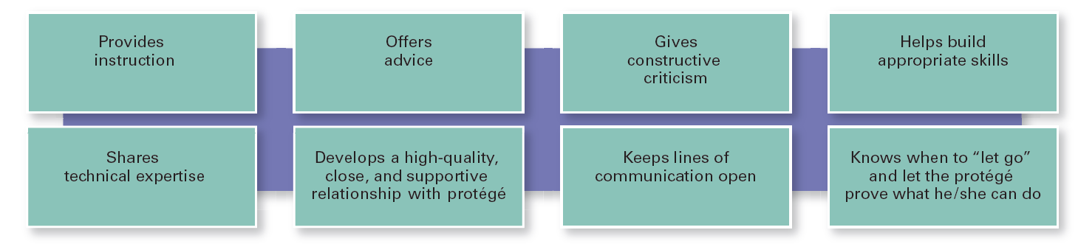
Figura 4-9
O que faz um bom mentor
Exhibit 4-9 looks at what a good mentor does.
Notes:
If an organization is serious about its commitment to diversity, it needs to have a mentoring program in place.
Sources: Based on J. Prime and C. A. Moss-Racusin, “Engaging Men in Gender Initiatives: What Change Agents Need to Know,” Catalyst, www.catalyst.org, 2009; T. J. DeLong, J. J. Gabarro, and R. J. Lees, “Why Mentoring Matters in a Hypercompetitive World,” Harvard Business Review, January 2008, pp. 115–121; S. N. Mehta, “Why Mentoring Works,” Fortune, July 9, 2001, p. 119; and D. A. Thomas, “Race Matters: The Truth About Mentoring Minorities,” Harvard Business Review, April 2001, pp. 99–107.

Slide 20
Ações da gestão de topo
Formação em competências relacionadas com a diversidade – formação especializada que visa sensibilizar os colaboradores sobre a importância da diversidade e desenvolver competências que melhorem o seu trabalho, em contexto de diversidade.
Notes:
Our human nature is to not accept or approach anyone who is different from us. But it doesn’t make discrimination of any type or form acceptable. And we live and work in a multicultural context. So the challenge for organizations is to find ways for employees to be effective in dealing with others who aren’t like them. That’s where diversity skills training, specialized training to educate employees about the importance of diversity and teach them skills for working in a diverse workplace, comes in.
Most diversity skills training programs start with diversity awareness training. During this type of training, employees are made aware of the assumptions and biases they may have. Once we recognize that, we can look at increasing our sensitivity and openness to those who are different from us.

Slide 21
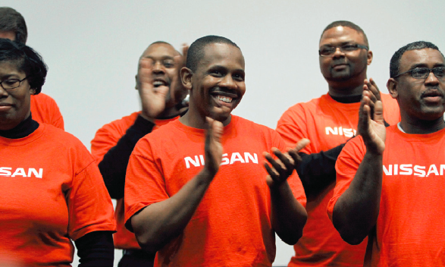
Ações da gestão de topo
Grupos de interesse
Grupos formados por empregados que partilham uma determinada dimensão de diversidade.
Notes:
Employee resource groups are made up of employees connected by some common dimension of diversity. Such groups typically are formed by the employees themselves, not the organizations. However, it’s important for organizations to recognize and support these groups.
Why are they so prevalent? The main reason is that diverse groups have the opportunity to see that their existence is acknowledged and that they have the support of people within and outside the group. Individuals in a minority often feel invisible and not important in the overall organizational scheme of things. Employee resource groups provide an opportunity for those individuals to have a voice.

Slide 22
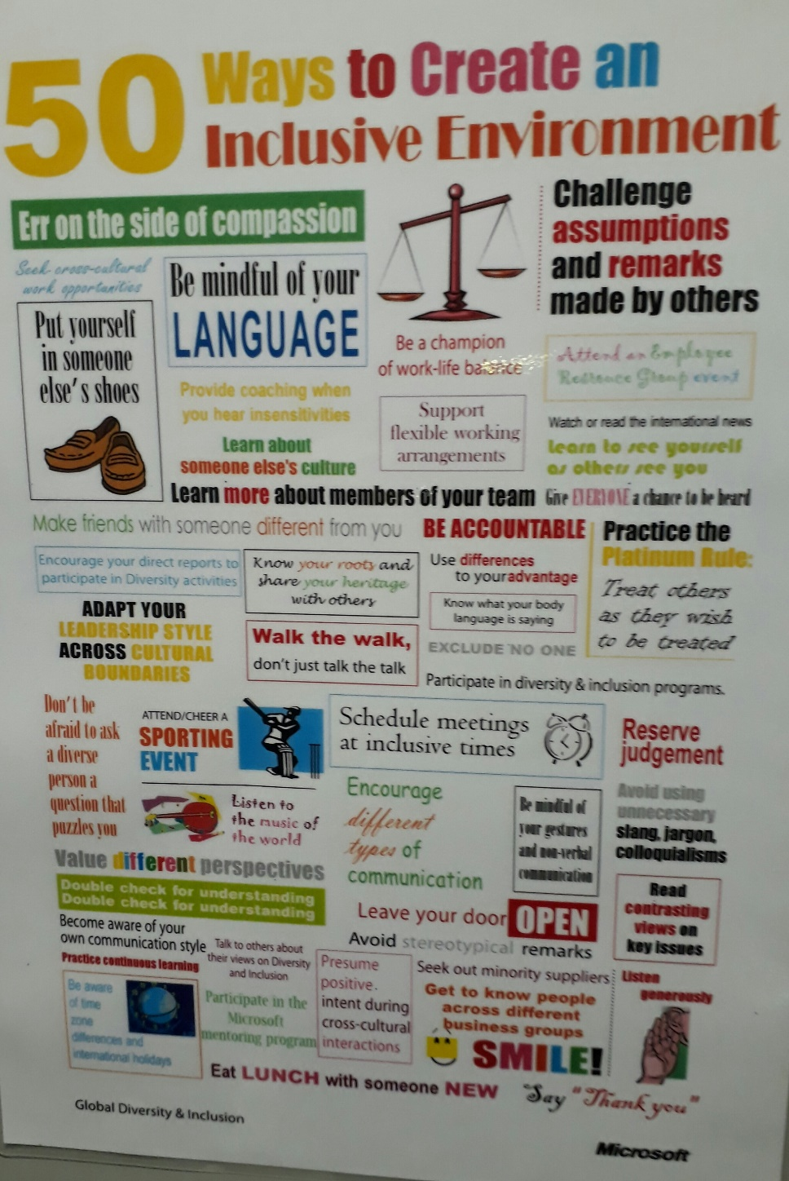
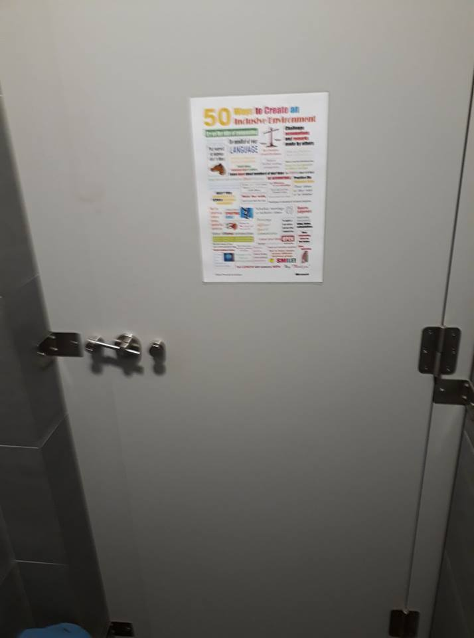
Exemplo da Microsoft
(Julho de 2017, Sede em Lisboa)
5 - 22

